Slide 2
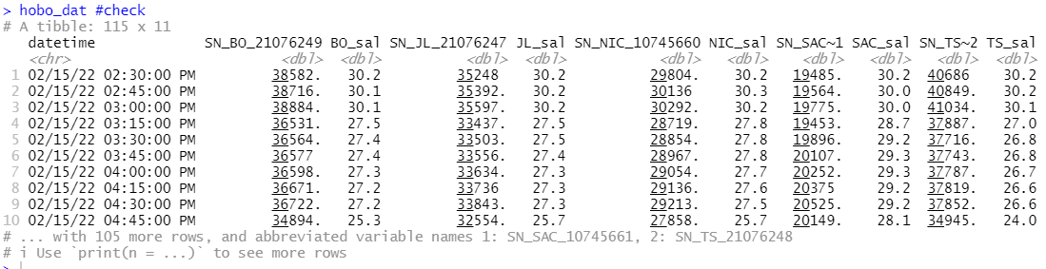
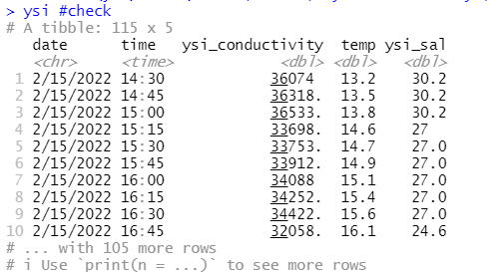
Salinity loggers

Slide 3
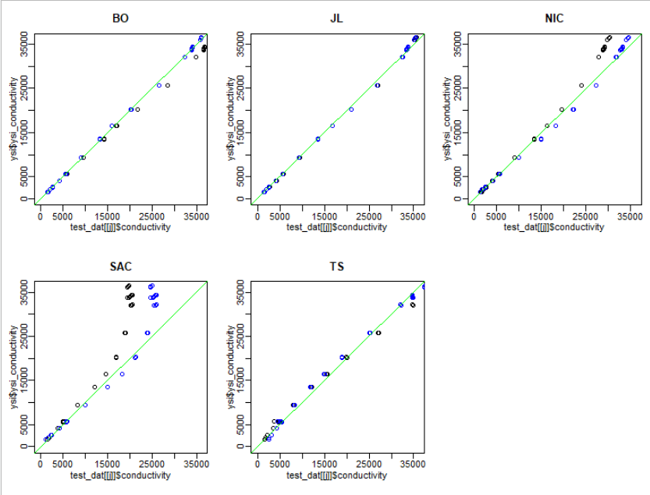
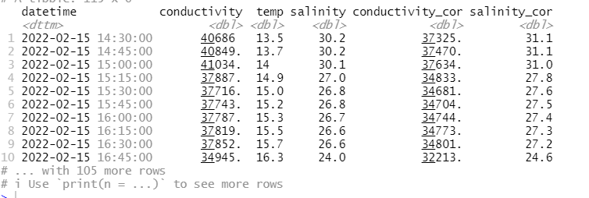

Slide 4
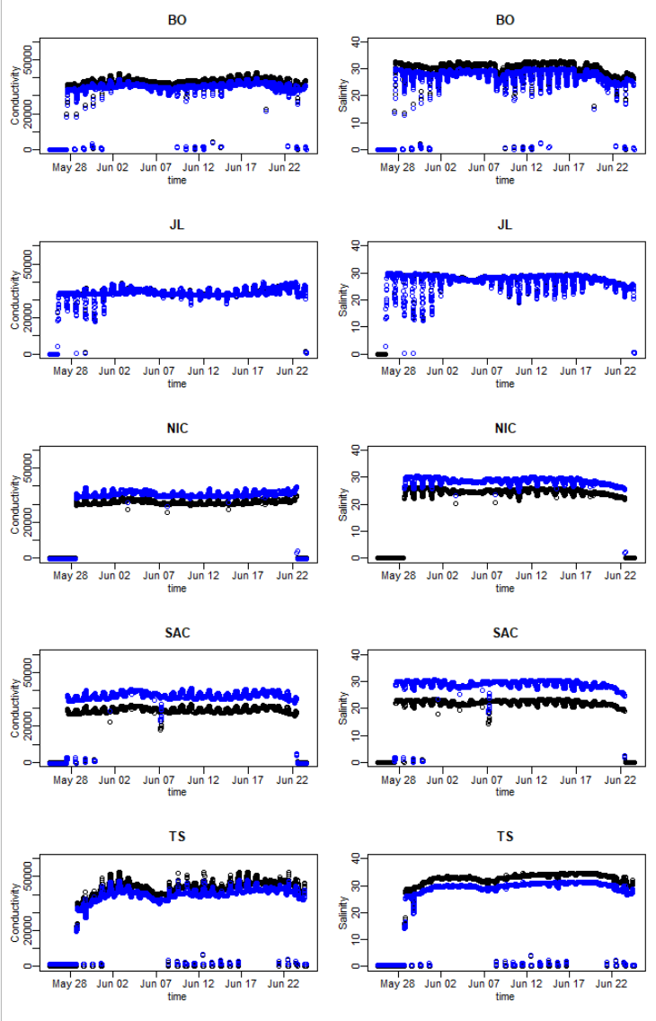
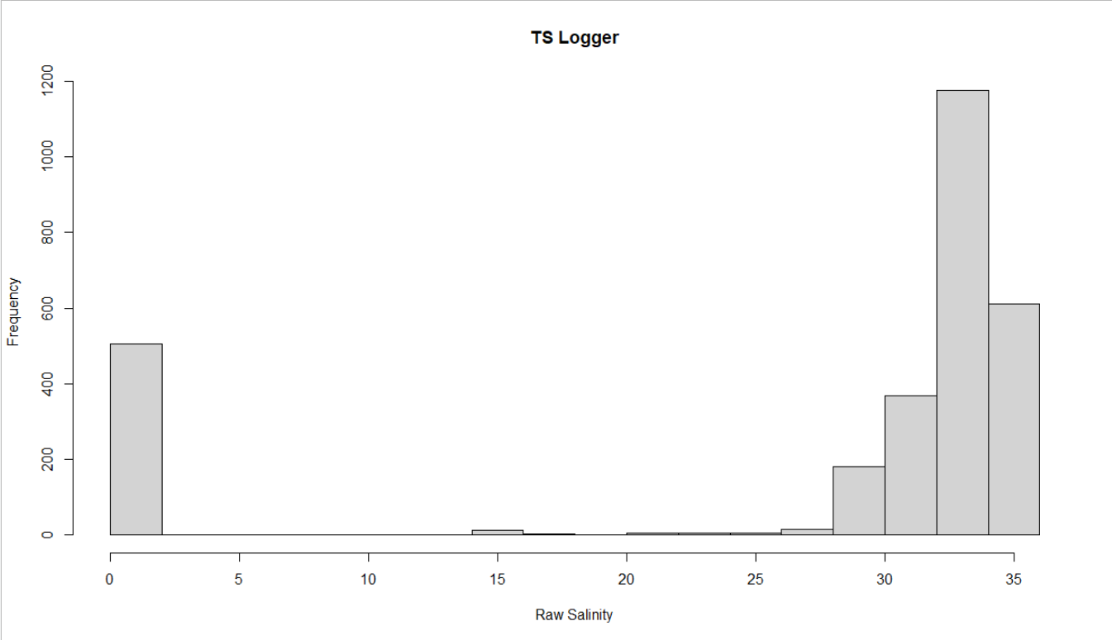
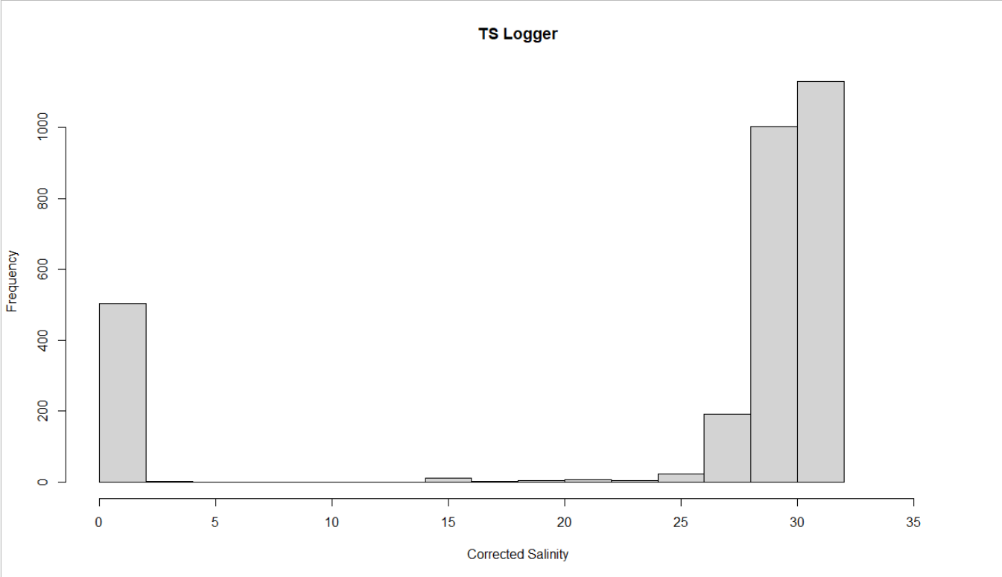

Slide 5
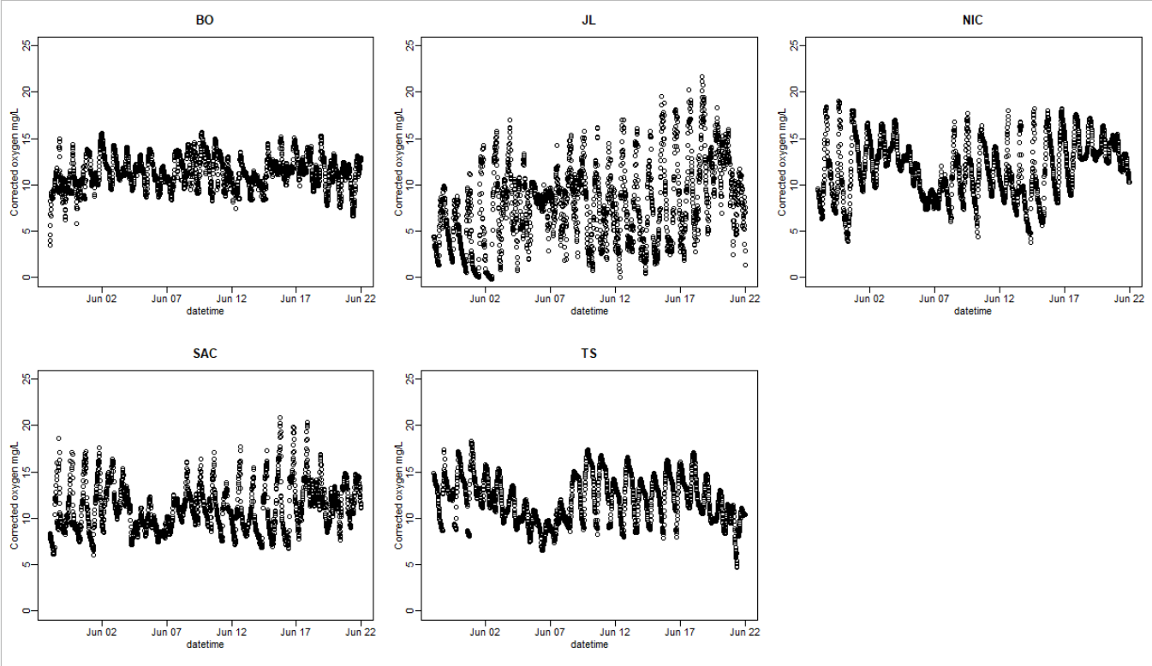
Corrected oxygen data
hobo
mini
mini
hobo
mini
Drift correction
Salinity correction

Slide 6
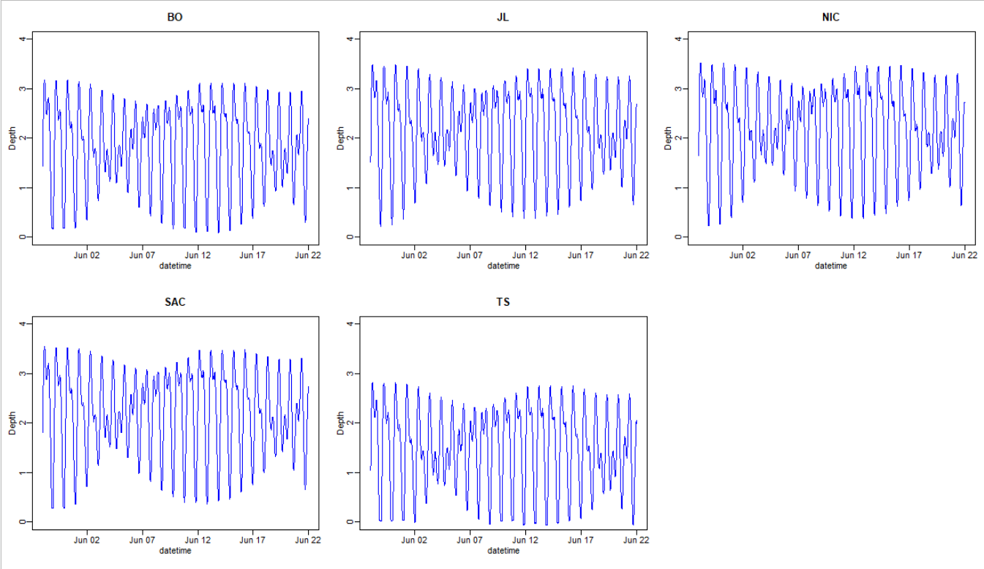
Depth/Tidal data

Slide 7
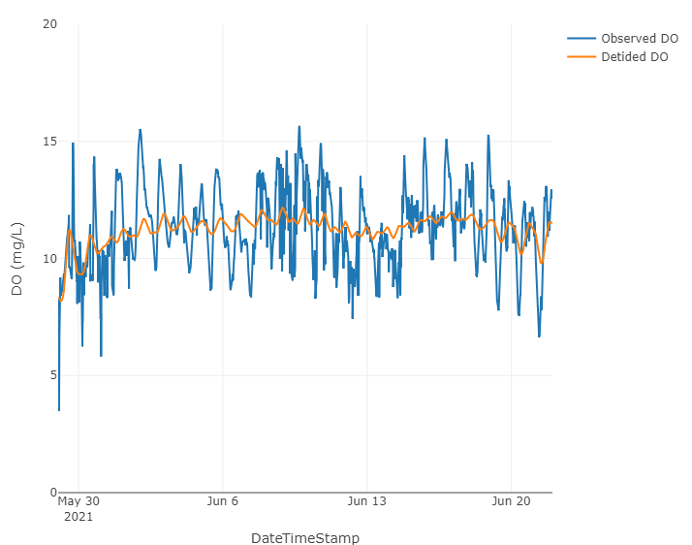
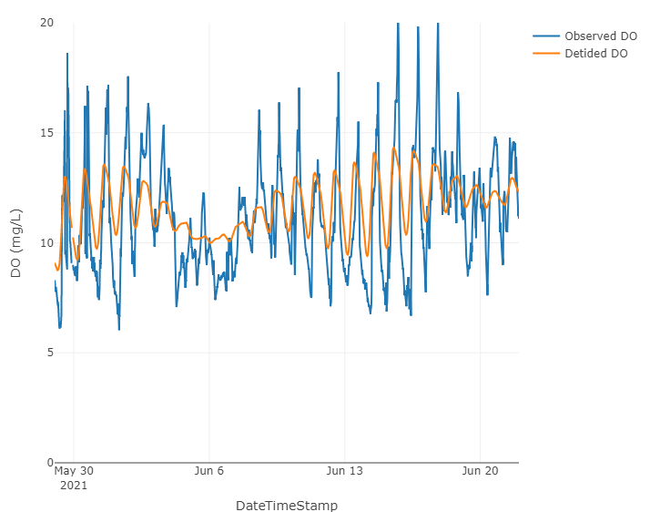
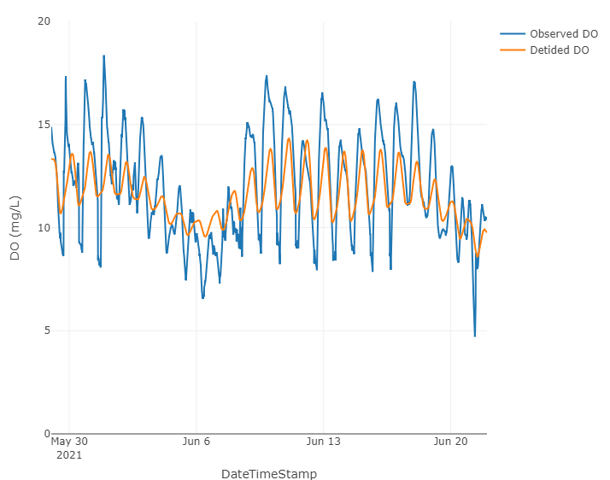
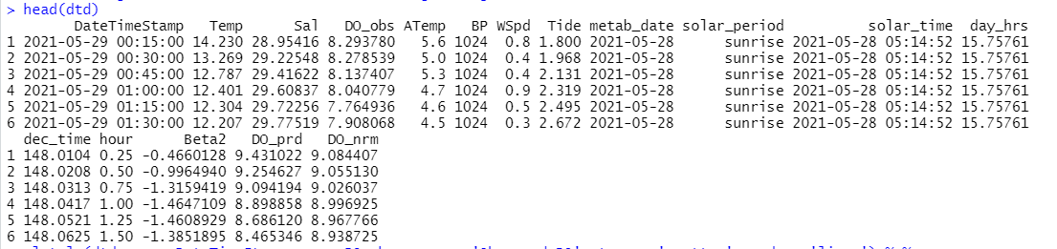
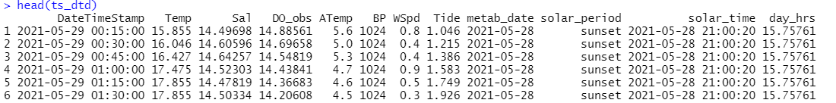
De-tided dissolved oxygen
Blau Oyster (Samish River)
SA-C
Taylor Shellfish

Slide 8
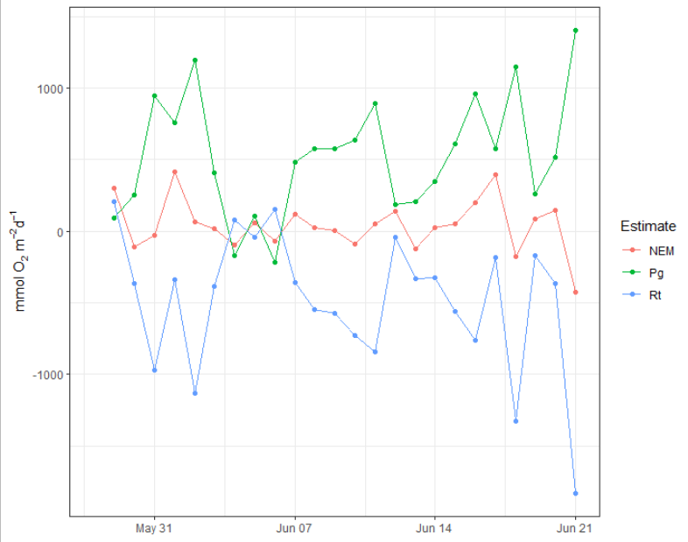
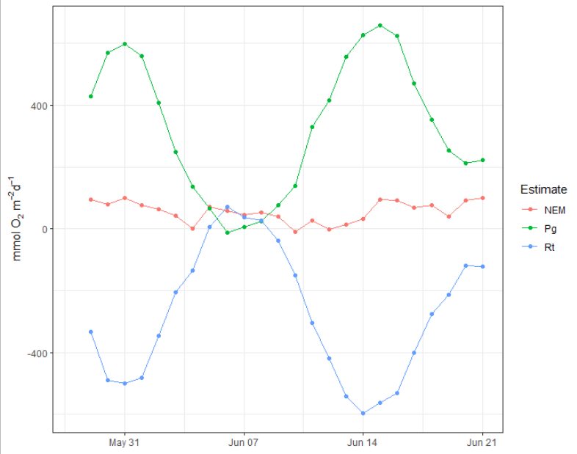
SA-C May-June metabolism
Pg | Rt | NEM
531.2 | -489.8 | 41.4
Pg | Rt | NEM
331.9 | -276.1 | 55.8

Slide 9
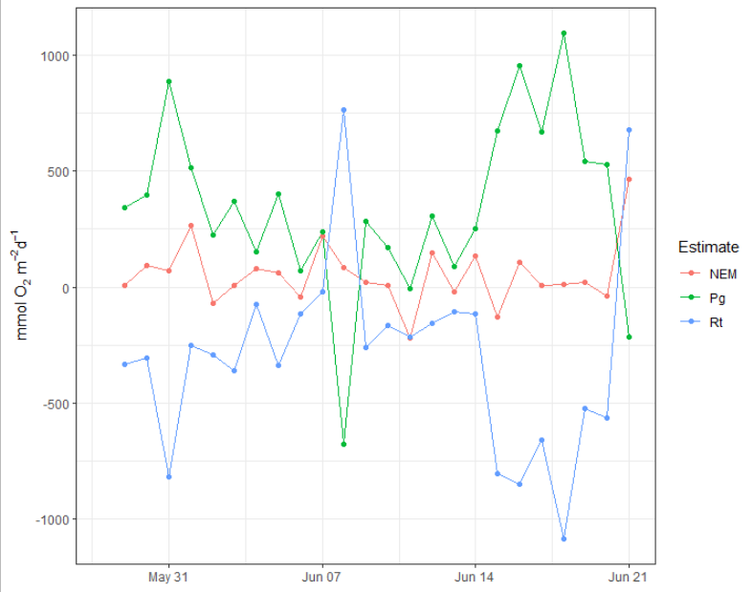
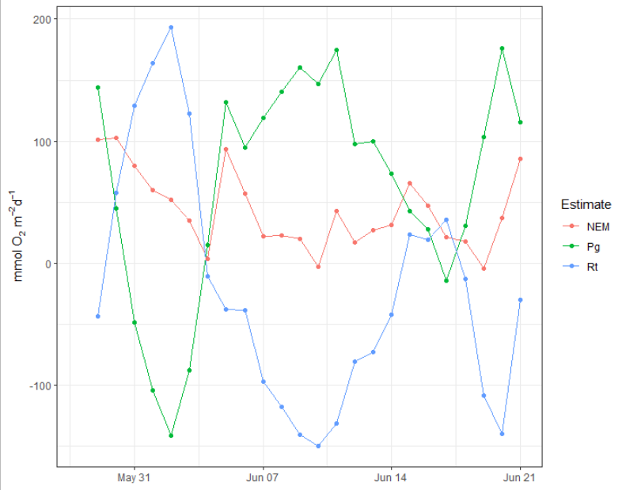
BO May-June metabolism
Pg | Rt | NEM
344.4 | -291 | 53.4
Pg | Rt | NEM
64.2 | -21.2 | 43

Slide 10
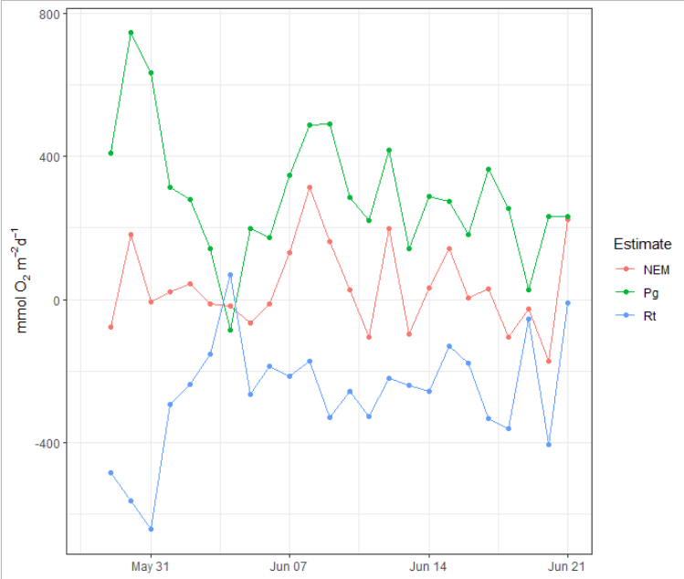
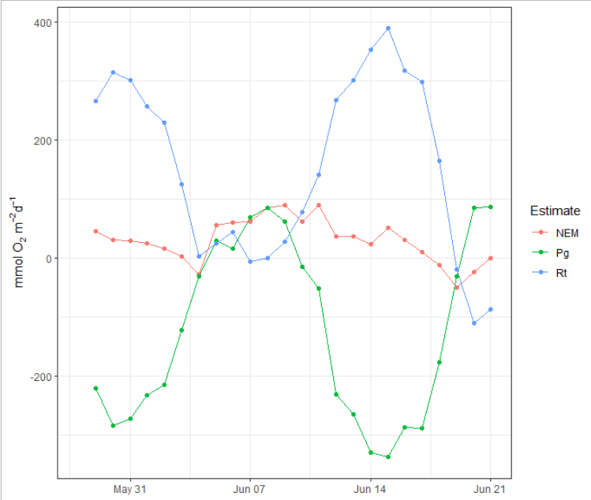
TS May-June metabolism ???

Slide 11
De-tided dissolved oxygen
Blau Oyster (Samish River)
SA-C
Taylor Shellfish

Slide 12
Next steps
Double check date times from start to finish
Mini dot vs hobo
Check depth/tidal loggers
Re-run metabolism code

